Slide 1

Internship Presentation on “Automated Attendance Application”
Bachelor of Science in Computer Science and Information Technology (BSc. CSIT)
Texas College
Mitrapark, Kathmandu
Affiliated with Tribhuvan University
Prepared By: Kunjung Sherpa
Roll Number: 2898/070

Slide 2

The environment you’re in shapes your thoughts, your actions and soon your future possibilities. Small cues from your environment that you receive on a daily basis over a long time changes you in so many ways you could hardly believe were true.
– Kunjung Sherpa

Slide 3
Overview
Introduction of the Company
Domain of the Company
Major Function of the Company
Internship Activities
Things Learnt from Internship
Snapshots
Conclusion

Slide 4
Ashleesha International
Located at Mulpani Chaur, Kathmandu, Nepal
Mentor: Mr. Prashant Dhungel (Project Manager)
Duration: Nov 09, 2017 – Feb 12, 2017
Timing: 11:00 A.M. – 5:00 P.M.

Slide 5




Domain of Ashleesha International
AI for Decision Support

Slide 6
Major Function of the Company
AI for Decision Support (e.g: eye disease diagnosis)
Custom Software Development
Web Application Design and Development

Slide 7
Internship Activities
Build a Automated Attendance App
Learning Amazon Web Services
Build a Proof of Concept Web App using AWS
Research Face Recognition and use it in the Attendance App
Communicate Project Status with Project Manager
Working on a Team to build Attendance Version 2 (still in progress)

Slide 8
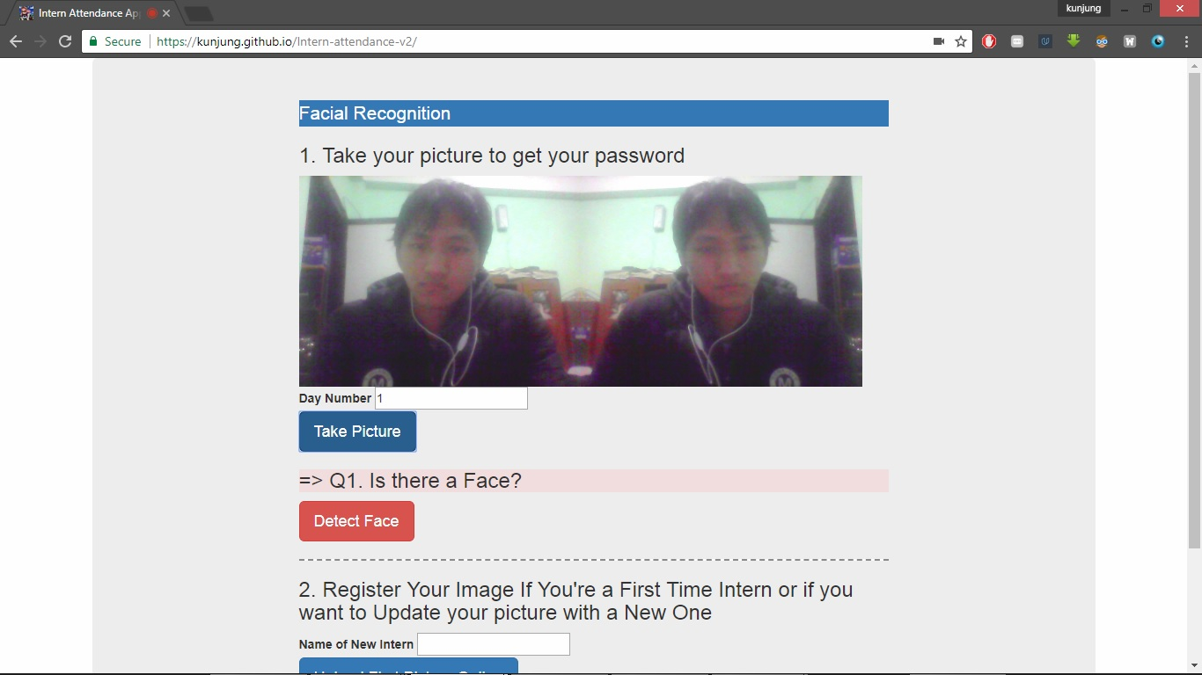
Building an Automated Attendance App

Slide 9
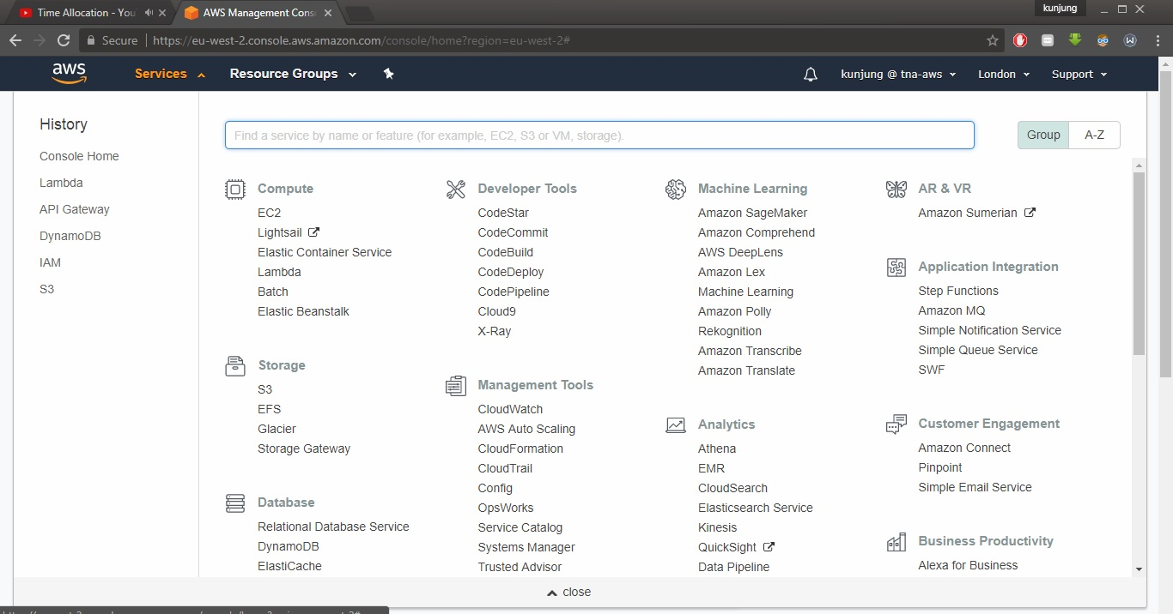
Learning Amazon Web Services

Slide 10
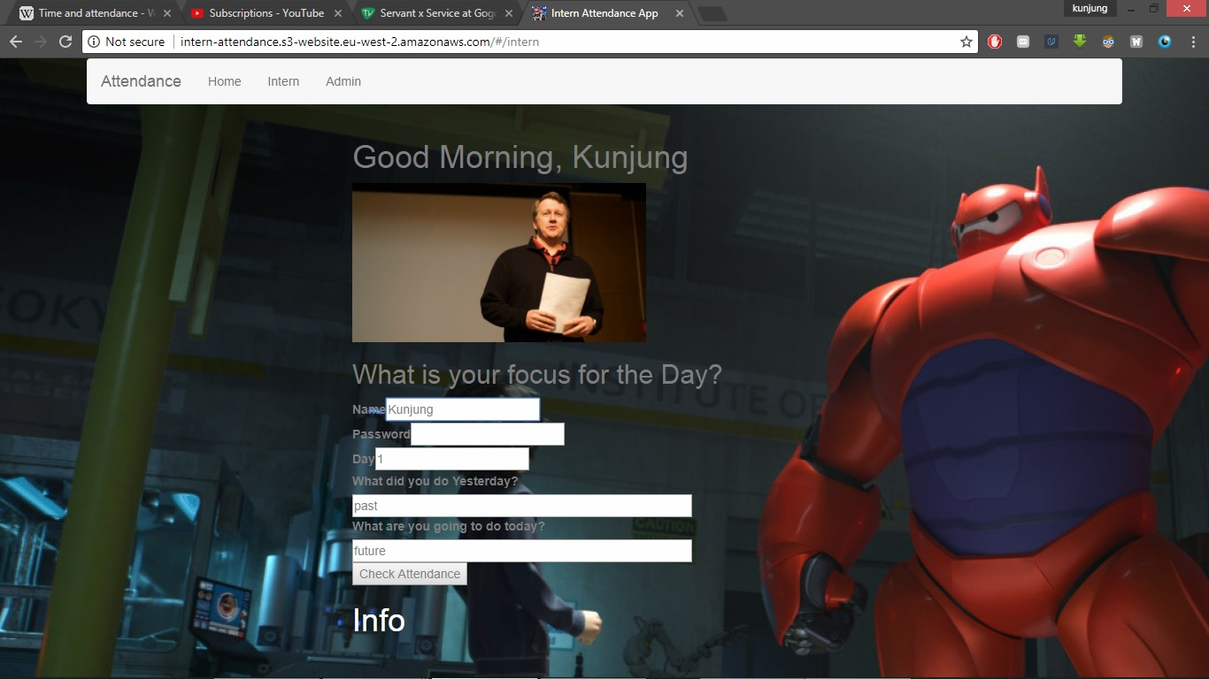
Build a Proof of Concept Web App using AWS

Slide 11
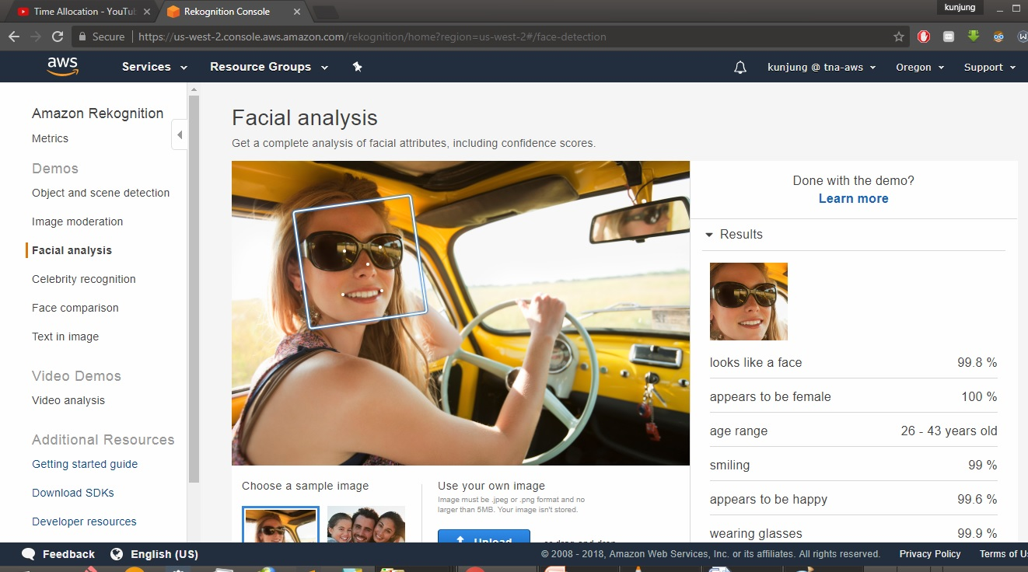
Research Face Recognition and use it in the Attendance App

Slide 12
Things Learnt in the Internship
Building web apps using AWS and Python
Learned a few AWS concepts (lambda, s3, dynamodb, rekognition, api gateway, etc)
Agile method using Trello boards and Slack
Communicating in a team
Recovering lost time
Not all skills are equal in value. Soft skills might be more valuable than CS skills

Slide 13
Conclusion
Real World is different from classroom Activity
Building Web Apps yourself is changing to merging and combining different readymade cloud products
Working in a Team is very different from working alone.
Develop few AWS Skills

Slide 14
Thank You!
Any Questions?

